Slide 1
GSBA 511: Managerial Economics
Prof. Akbulut
Chapter 2

Slide 2
Chapter 2: Outline
Production Possibilities Frontiers and Opportunity Costs
Comparative Advantage and Trade
The Market System

Slide 3
Trade-offs in Production
Goods and services and the economic resources used to make them, or factors of production—workers, capital, natural resources, and entrepreneurial ability—are scarce
Hence a decision on which good (model) to produce, involves trade-offs.
We can illustrate the trade-off in production, and the opportunity cost of producing a certain good using a Production Possibility Frontier (PPF).

Slide 4
Production possibilities frontier (PPF)
A graph or table showing the maximum attainable combinations of two products that may be produced with available resources and current technology.

Slide 5
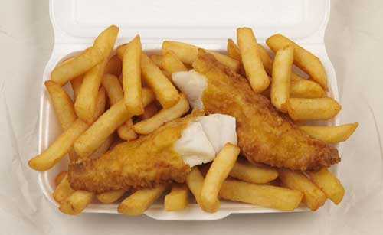
Active Learning
Production Possibilities Frontier
FISH | CHIPS
20 | 0
18 | 1
16 | 2
14 | 3
12 | 4
10 | 5
8 | 6
6 | 7
4 | 8
2 | 9
0 | 10
What is the opportunity cost of one unit of fish (F)?
What is the opportunity cost of one unit of chips (C)?
Can you write a linear equation, F = a + b C, representing the PPF?
Can you draw a PPF, putting fish (F) on the y-axis and chips (C) on the x-axis?

Slide 6
Active Learning
Production Possibilities Frontier
FISH | CHIPS
20 | 0
18 | 1
16 | 2
14 | 3
12 | 4
10 | 5
8 | 6
6 | 7
4 | 8
2 | 9
0 | 10

Slide 7
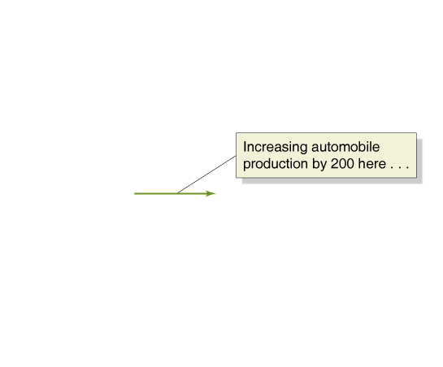
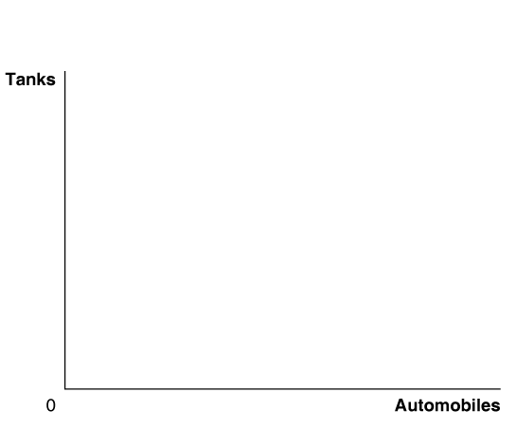
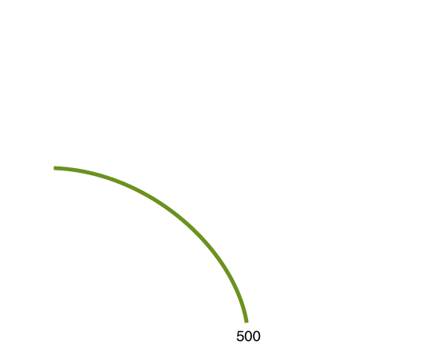
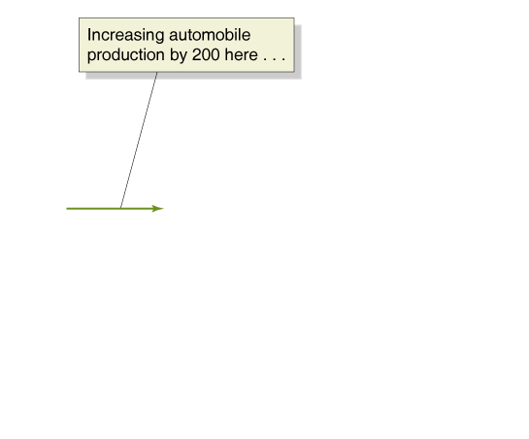
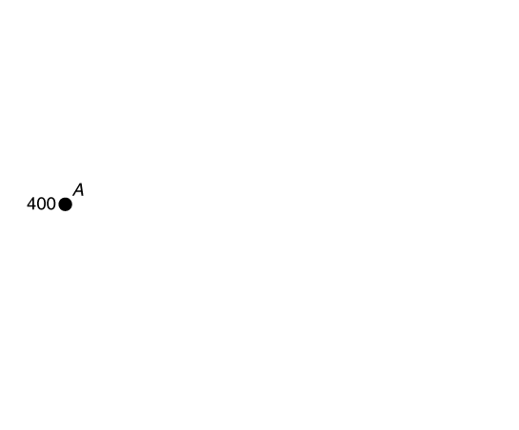
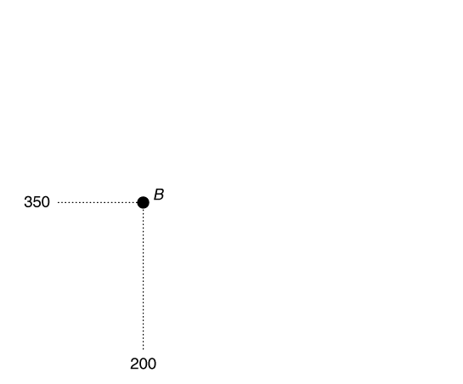
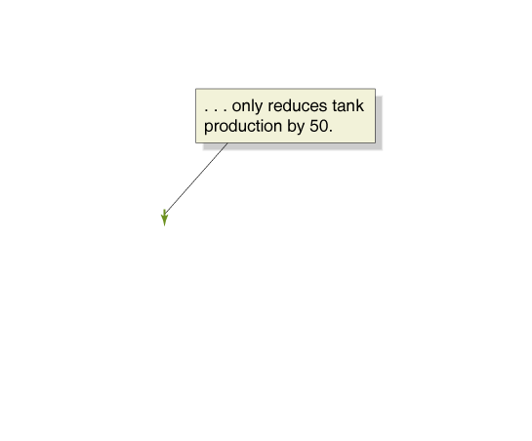
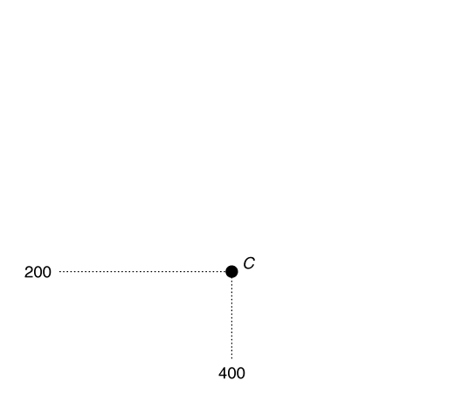
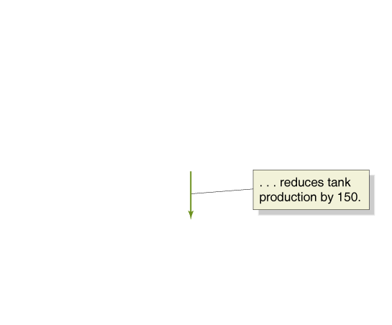
Non-Constant Opportunity Cost
Increasing Marginal Opportunity Costs
The more resources already devoted to an activity, the smaller the payoff to devoting additional resources to that activity.

Slide 8
How would you illustrate economic growth or growth of a firm, namely the ability to increase the production of goods and services, using the PPF model?
⇒ Through shifts in the PPF

Slide 9
Comparative Advantage and Trade
Absolute Advantage
The ability of an individual, a firm, or a country to produce more of a good or service than competitors, using the same amount of resources.
Comparative Advantage
The ability of an individual, a firm, or a country to produce a good or service at a lower opportunity cost than competitors.
⇒ Comparative advantage is the basis of trade.

Slide 10
Gains from Trade
ICELAND
GERMANY
FISH | CHIPS
20 | 0
18 | 1
16 | 2
14 | 3
12 | 4
10 | 5
8 | 6
6 | 7
4 | 8
2 | 9
0 | 10
FISH | CHIPS
0 | 20
1 | 18
2 | 16
3 | 14
4 | 12
5 | 10
6 | 8
7 | 6
8 | 4
9 | 2
10 | 0
Which country has an absolute advantage in fish, which in chips?
Iceland in Fish
Germany in Chips
Which country has a comparative advantage in fish, which in chips?

Slide 11
Gains from Trade
ICELAND
GERMANY
FISH | CHIPS
20 | 0
18 | 1
16 | 2
14 | 3
12 | 4
10 | 5
8 | 6
6 | 7
4 | 8
2 | 9
0 | 10
FISH | CHIPS
0 | 20
1 | 18
2 | 16
3 | 14
4 | 12
5 | 10
6 | 8
7 | 6
8 | 4
9 | 2
10 | 0
Iceland’s opportunity cost of chips:
Germany’s opportunity cost of chips:
2 units of fish
½ unit of fish
Iceland’s opportunity cost of fish:
Germany’s opportunity cost of fish:
½ unit of chips
2 units of chips
Iceland has a comparative advantage in fish, and Germany in chips.

Slide 12
Gains from Specialization and Exchange
 | Iceland’s fish | Iceland’s chips | Germany’s fish | Germany’s chips
Pre trade | 15 | 2.5 | 4 | 12
Production with specialization | 20 | 0 | 0 | 20
Consumption after trade (assume trade takes place at 1:1) | 15 (let’s assume Iceland’s fish consumption doesn’t change) | 5 (in exchange for 5 fish) | 5 (=20 – 15) | 15 (left after trading 5 to Iceland)
Net change | 0 | +2.5 | +1 | +3
F
20
15
10
PPF_{I}
Both Iceland and Germany are able to consume beyond their production possibility frontier! That’s what we mean by gains from trade
5
PPF_{G}
4
2.5
5
C
10
12
15
20

Slide 13
Active Learning: Comparative Advantage and the Gains from Trade
Suppose that France and Germany both produce schnitzel and wine, which sell for the same prices in both countries. These are the combinations of the two goods that each country can produce in one day using the same amounts of capital and labor:
France |  | Germany
Wine (bottles) | Schnitzel (pounds) | Wine (bottles) | Schnitzel (pounds)
0 | 8 | 0 | 15
1 | 6 | 1 | 12
2 | 4 | 2 | 9
3 | 2 | 3 | 6
4 | 0 | 4 | 3
 |  | 5 | 0
Who has an absolute advantage in producing wine, who in producing Schnitzel?
Who has a comparative advantage in producing wine, who in producing Schnitzel?
In what price range for wine do both countries benefit from trade?

Slide 14
Active Learning: Comparative Advantage and the Gains from Trade
France |  | Germany
Wine (bottles) | Schnitzel (pounds) | Wine (bottles) | Schnitzel (pounds)
0 | 8 | 0 | 15
1 | 6 | 1 | 12
2 | 4 | 2 | 9
3 | 2 | 3 | 6
4 | 0 | 4 | 3
 |  | 5 | 0
Who has an absolute advantage in producing wine, who in producing Schnitzel?
Germany has an absolute advantage in the production of Schnitzel and and wine.
Who has a comparative advantage in producing wine, who in producing Schnitzel?
Germany has a comparative advantage in Schnitzel production and France in wine.
In what price range for wine do both countries benefit from trade?
2S ≤ PW ≤ 3S or 1/3W ≤ PS ≤ 1/2W

Slide 15
Market Mechanism
Individuals usually act in a rational, self-interested way.
Free market economist believe that this leads to socially optimum (efficient) outcomes.
resources are directed to their highest-valued uses

Slide 16
In a famous phrase, Adam Smith said that firms would be led by the “invisible hand” of the market to provide consumers with what they want. What is this invisible hand?

Slide 17
Reasons that markets can fail in allocating resources efficiently
Market power on the part of either sellers or buyers: monopoly and monopsony
Externalities: spillover effects that are not priced by markets
Asymmetric information: either buyers or sellers might know more about some aspect of the product than the other party does.
Public goods: some goods are non-exclusive and non-rival in consumption (free-rider effects)

